Slide 1
DEVELOPMENT OF HEAD AND NECK I
Dr. Mbira

Slide 2
The head and neck is formed from mesenchyme derived from:
Paraxial mesoderm(somites and somitomeres) – Parts of the skull, skeletal muscles of the head.
Lateral plate mesoderm – Cartilages and other tissues of the larynx.
Ectodermal placodes – Contribute to formation of sensory ganglia of some of the cranial nerves.
Neural crest cells – Form midfacial and neck skeletal and soft tissue structures.
The hallmark of head and neck development is the formation of the pharyngeal arches which contribute to formation of the face as well as the neck. These are mesenchymal bars which form at week 4-5 and give the embryo at this stage its characteristic appearance in the cranial region resembling gills (branchia).

Slide 3
The skull/cranium
Comprised of the neurocranium and viscerocranium.
The neurocranium is further divided into the bones of the vault(membranous part) and cartilaginous part(chondrocranium).
The membranous part of the neurocranium is formed by neural crest cells and somitomeres from paraxial mesoderm which form a sheet covering the brain and undergo membranous ossification to form flat bones that approximate each other to form the vault.
The base of the skull is formed from neural crest cells(anterior to sella turcica) and occipital somites forming sclerotomes(posterior to sella turcica), both of which form cartilaginous models that fuse together and undergo endochondral ossification.

Slide 4
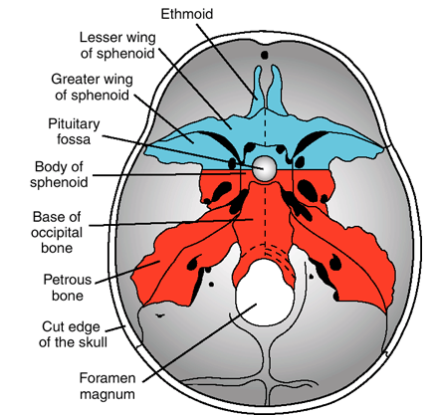

Slide 5
The viscerocranium(bones of the face) is formed mainly from the derivatives of the 1st and 2nd pharyngeal arches. The 1st arch has the following:
Maxillary process – maxilla, zygomatic arch, part of the temporal bone
Mandibular process – Meckel cartilage which in turn gives rise to the mandible and whose remnant persists as the sphenomandibular ligament.
The 2nd arch together with a tip from the mandibular process gives rise to the ossicles of the middle ear. They are the 1st bones to ossify, doing so in the 4th month.
The rest of the facial bones are derived from neural crest cells.

Slide 6
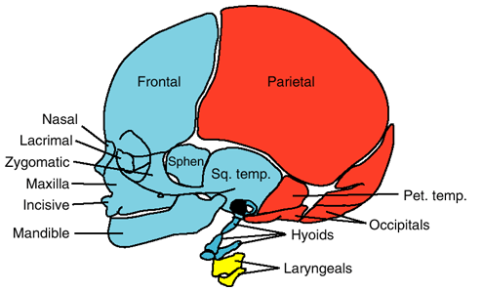
Red- somites and somitomeres
Blue- neural crest
Yellow- lateral plate mesoderm

Slide 7
Pharyngeal/branchial arches
Develop from the 4th to the 5th week as neural crest cells migrate to the head and neck region.
The 1st pair of arches appear as surface elevations at the level of the developing pharynx.
By the end of the 4th week, the first 4 arches are visible as ridges on the surface of the embryo.
The 5th and 6th arches develop soon after but are more rudimentary and thus are not visible externally.
Each pharyngeal arch is comprised of a core of mesenchymal tissue covered externally by ectoderm and lined on the inside by epithelium derived from endoderm.

Slide 8
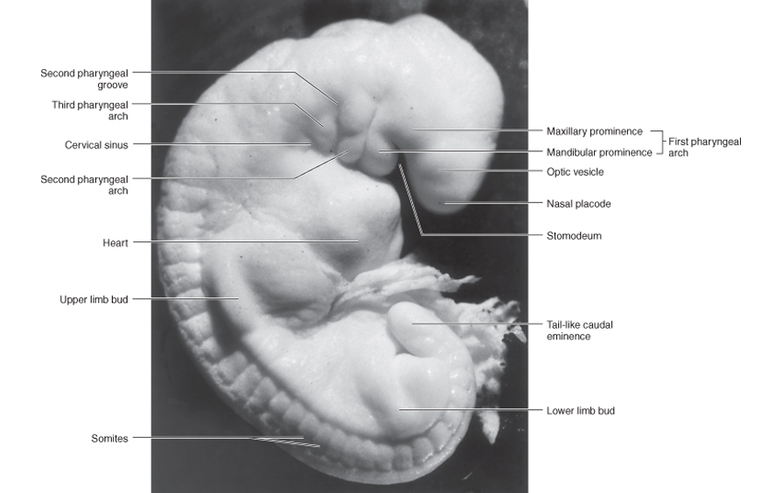

Slide 9
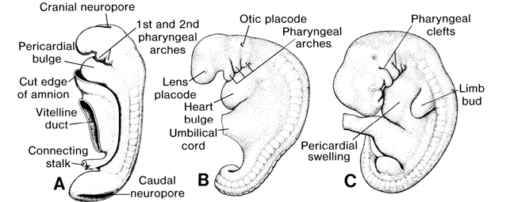

Slide 10
The mesenchyme in each arch is derived from mesoderm(lateral plate and paraxial) which gives rise to the musculature.
Each arch also receives neural crest cells which give rise to skeletal structures.
Each arch receives its own arterial component as well as a cranial nerve, thus the structures of each arch carry their nerves and vessels with them as they migrate to their final location.
Thus, a typical arch contains:
A pharyngeal arch artery that arises from the truncus arteriosus of the primordial heart.
A cartilaginous rod that forms the skeleton of the arch.
Muscular component that differentiates into the muscles.
Nerves that supply the muscles and other soft tissues derived from the arch.

Slide 11
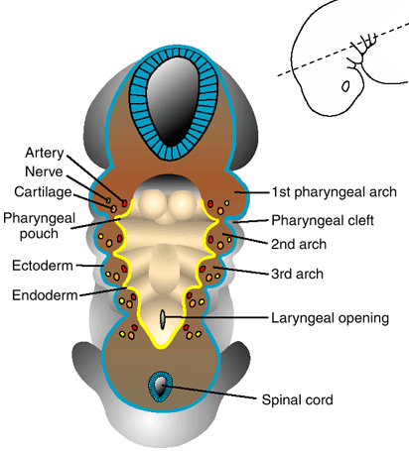

Slide 12
The pharyngeal arches are named cranio-caudally.
Separating each arch is a pharyngeal groove/cleft which corresponds to an outpouching (pharyngeal pouch) on the inside of the primordial foregut lining in the region of the pharynx.
While there are 6 pharyngeal arches, practically only 4 are considered due to the fact that arches V-VI are rudimentary and tend to merge with IV.

Slide 13
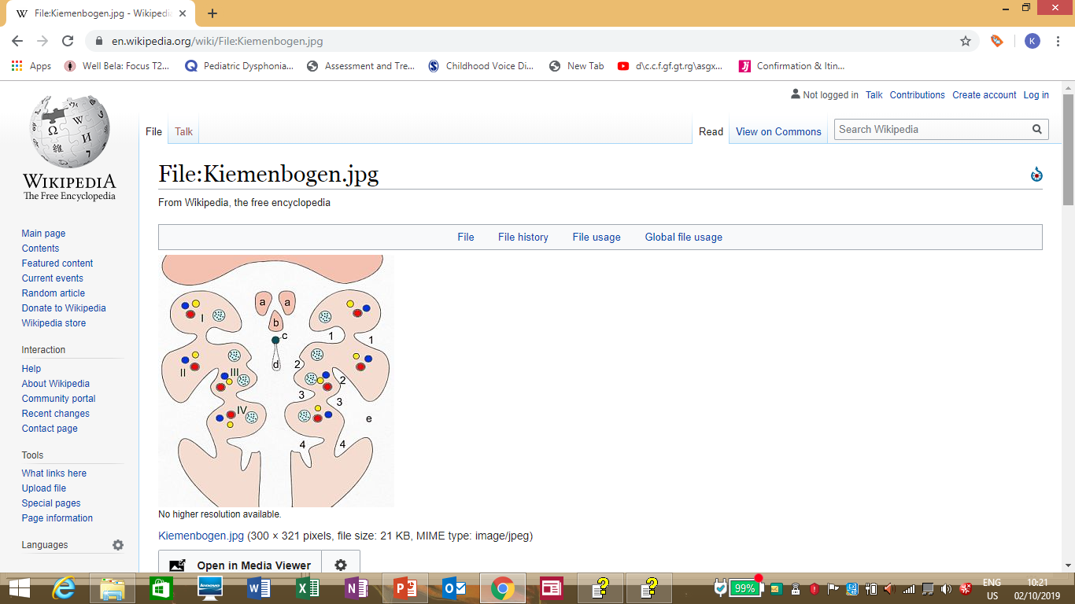
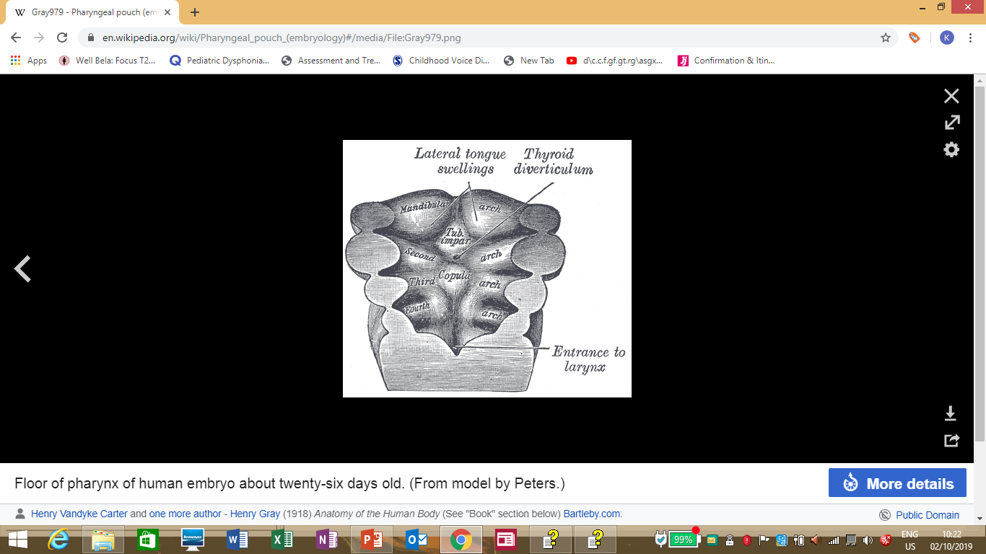

Slide 14
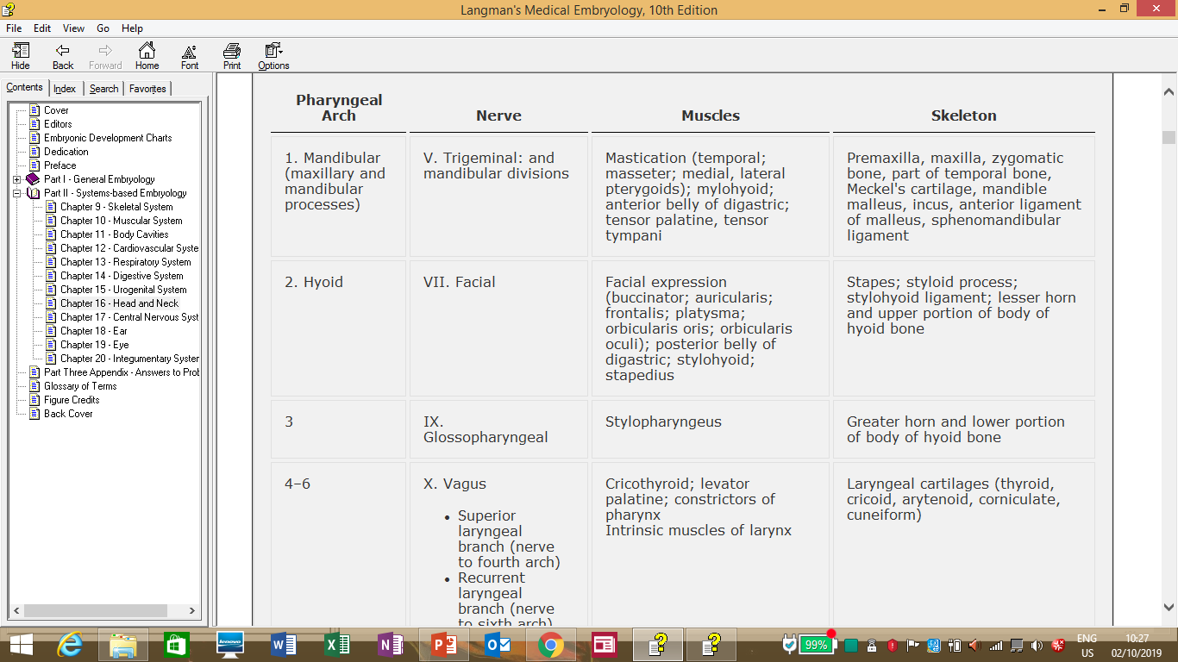
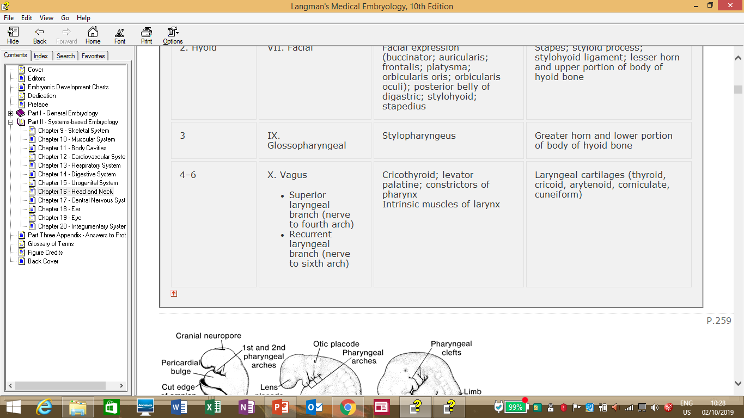

Slide 15
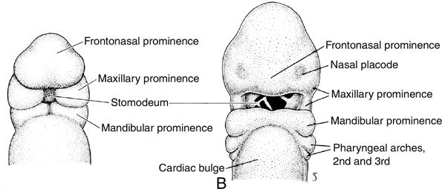
By the 4th week, primordial facial structures can be seen, mainly the stomodeum(future mouth) surrounded by mandibular and maxillary prominences as well as the frontonasal prominence.
Later the nasal prominences will appear at about week 6

Slide 16
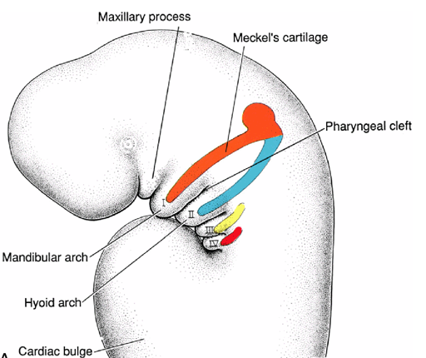

Slide 17
Arch I
Consists of a dorsal maxillary process and a ventral mandibular process.
The mandibular process contains the Merkel’s cartilage. Most of the Merkel’s cartilage will later disappear except its dorsal portion which will persist as the malleus and incus. Also the mesenchyme surrounding the Merkel’s cartilage will form the mandible through membranous ossification.
The maxillary process will form the maxilla, zygomatic bone and part of the temporal bone.
The 1st arch will also contribute muscles:
Muscles of mastications(pterygoids, masseter, temporalis).
Muscles in the neck – anterior belly digastric, mylohyoid.
Muscles in the ear and pharynx – tensor tympani and tensor veli palatini.

Slide 18
Muscles of the 1st arch are supplied by the mandibular division of trigeminal nerve.

Slide 19
Arch II
The 2nd arch is also known as the hyoid arch and its cartilage is also known as Reichert’s cartilage.
This cartilage dorsally gives rise to:
Stapes of the middle ear
Styloid process of temporal bone
Stylohyoid ligament
Ventrally the cartilage gives rise to:
Hyoid bone – lesser horn and upper part
The nerve of the 2nd/hyoid arch is the facial nerve which supplies the muscles of facial expression.

Slide 20
The musculature of the 2nd arch comprises the muscles of facial expression as well as:
Stapedius
Stylohyoid
Posterior belly of digastric
Auricular muscles

Slide 21
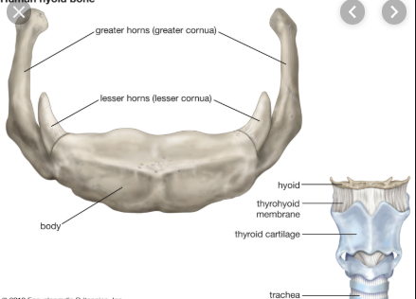
Arch III
The cartilage of the 3rd arch gives rise to the lower part of the body of hyoid bone as well as its greater horn.
Muscle:
Stylopharyngeus
Nerve:
Glossopharyngeal nerve

Slide 22
Arch IV-VI
The 5th arch is rudimentary and disappears soon after its formation, contributing nothing to the structures of the head and neck.
The 4th and 6th arches give rise to cartilages which fuse to form the cartilages of the larynx:
Thyroid cartilage
Arytenoids
Cricoid cartilage
Corniculate cartilage
Cuneiforms

Slide 23
Muscles of the 4th arch are the pharyngeal muscles:
Cricothryoid
Levator palatini
Pharyngeal constrictors
Muscles of the 6th arch:
Intrinsic muscles of the larynx except cricothyroid.
Nerve of the 4th arch:
Superior laryngeal nerve
Nerve of the 6th arch:
Recurrent laryngeal nerve

Slide 24
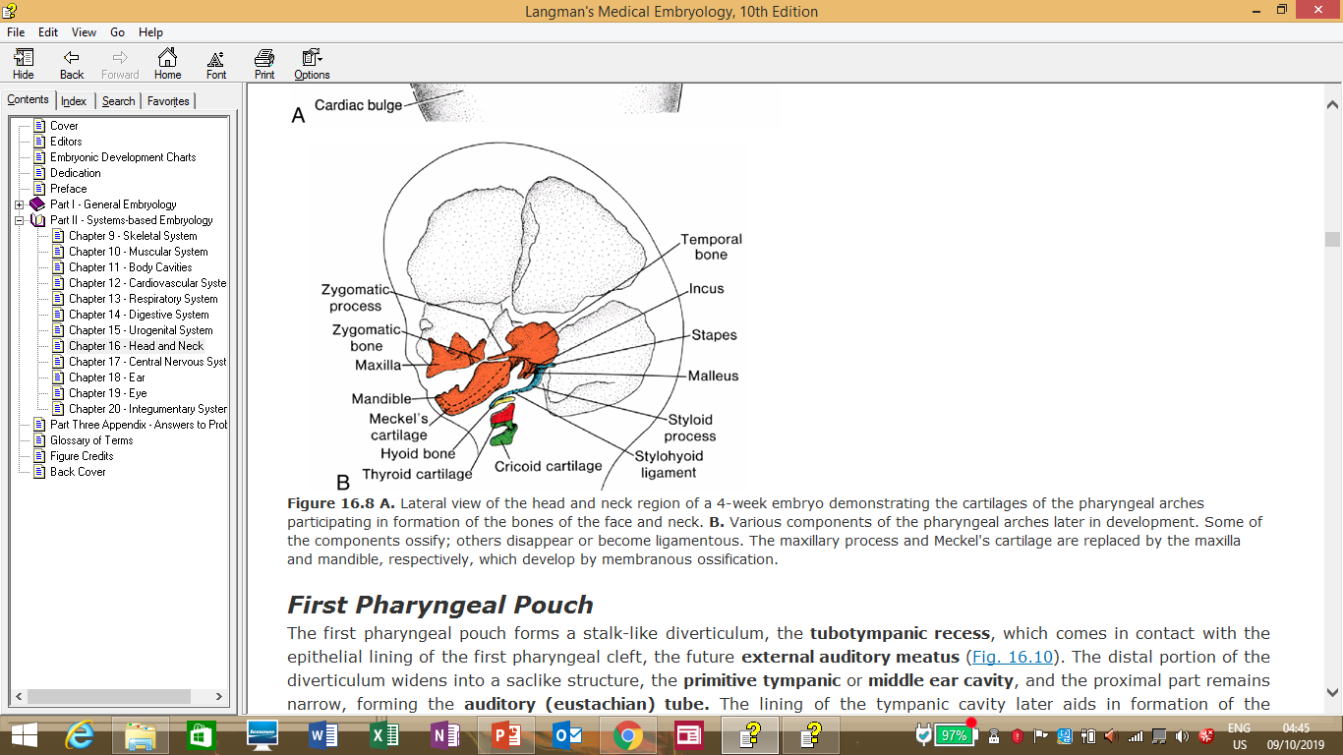
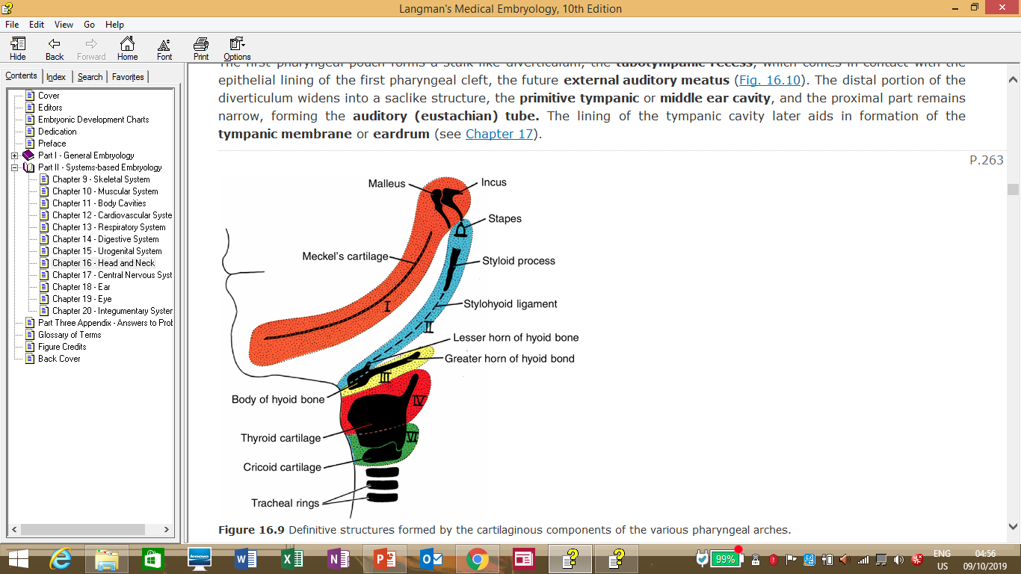

Slide 25
Pharyngeal pouches
The pharyngeal arches are bulges of mesenchyme seen on the outside separated by pharyngeal clefts. These arches and clefts correspond with bulges and recesses on the inside(the lateral walls of primordial foregut) known as pharyngeal pouches.
There are 5 pouches lined by endoderm and the 5th pouch is considered together with the 4th.

Slide 26
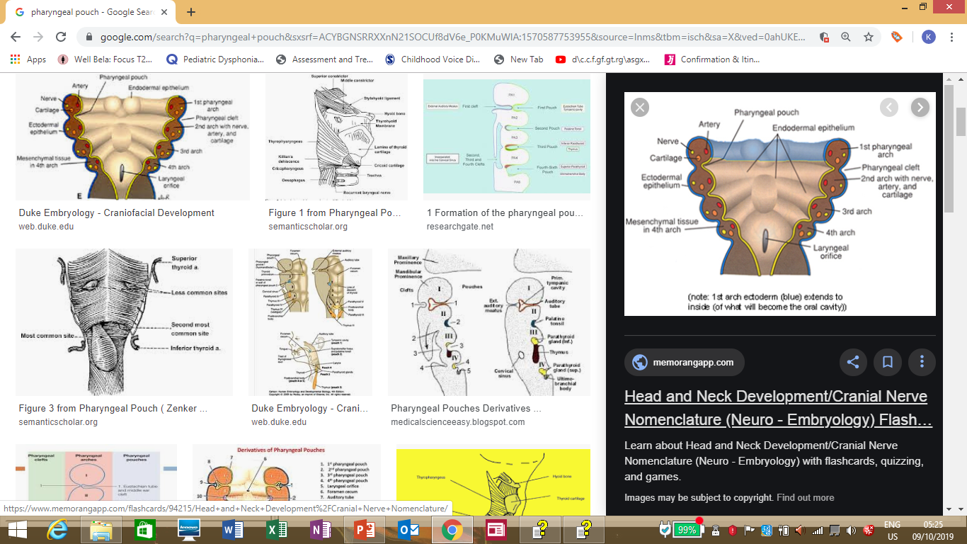
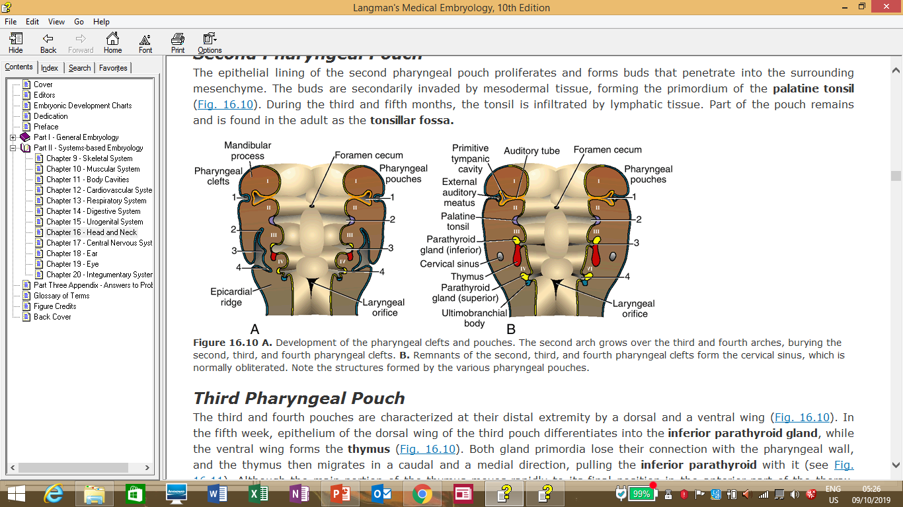

Slide 27
Pouch I
The 1st pharyngeal pouch gives rise to the tubotympanic recess which deepens until it comes into contact with the 1st pharyngeal cleft.
Later, the distal part of the recess widens into a sac-like structure which will give rise to the middle ear cavity while the proximal part remains narrow to form the Eustachian tube.
The epithelium of the middle ear cavity/tympanic cavity later forms the eardrum.

Slide 28
Pouch II
The 2nd pouch gives rise to the palatine tonsil.
The epithelium proliferates and forms buds which penetrate the underlying mesenchyme to form the primordial tonsil. The central part of these buds breaks down to form pit like depressions (tonsillar crypts).
Later in the 5th month it is invaded by lymphatic tissue.
The remnant of the pouch is the tonsillar fossa within which the tonsil rests.

Slide 29
Pouch III
The 3rd pouch forms a dorsal and ventral wing.
The epithelium of the ventral wing in the 5th week forms the inferior parathyroid gland.
The dorsal wing forms the thymus.
Later, the 2 structures break away from the the pharyngeal epithelium and migrate caudally and medially.
The inferior parathyroid settles in the neck on the posterior surface of the thyroid gland while the thymus migrates further caudally to settle in the anterior of the chest behind the sternum.
Remnant tissue of the thymus may be found in the neck.
The thymus plays an important role in childhood and is thus a considerably large retrosternal structure but in adulthood it atrophies and is replaced by fat.

Slide 30
Pouch IV
The 4th pouch like the 3rd has a dorsal and ventral wing.
The dorsal wing gives rise to the superior parathyroid gland which detaches from the pharyngeal epithelium and attaches to the dorsal aspect of the caudally migrating thyroid gland.
The ventral part of the 4th pouch is considered with the 5th pouch and together they give rise to the ultimobrachial body which later becomes the parafollicular C cells of the thyroid gland that secrete calcitonin.

Slide 31
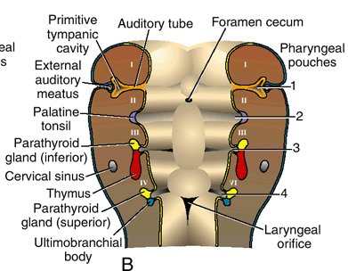

Slide 32
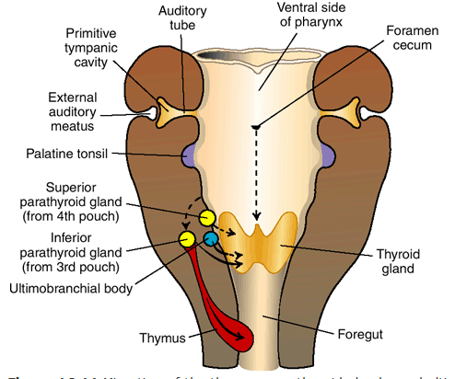

Slide 33
Pharyngeal clefts
At 5 weeks, the embryo has 4 clefts. The lower 3 clefts are overgrown by mesenchyme of the 2nd arch which eventually joins the epicardial ridge in the lower part of the neck closing off the 3 clefts from the outside.
The cavity formed by the 3 clefts is lined by ectoderm and is called the cervical sinus. With further development of the embryo, the sinus disappears.
The 1st cleft meanwhile penetrates the underlying mesenchyme to form the external auditory meatus. The epithelium at the end of this meatus forms the external part of the eardrum.

Slide 34
Pharyngeal membranes
These are areas where pharyngeal clefts and pouches approach each other to be separated by a thin rim of mesenchyme.
The only significant membrane is that between the 1st cleft and groove which gives rise to the tympanic membrane/eardrum.

Slide 35
*Branchial cyst/sinus/fistula
*Piriform sinus fistula
*1st arch syndrome
*Di George syndrome
*Abnormalities of parathyroids and thymus
Abnormal migration of neural crest cells

